Slide 1

Email Spam Detection
Batch -6
A.Rachana(20KN1A4204)
M.Haritha(20KN1A4234)
M.Bhanu Sri(20KN1A4235)
T.Sai Sundar(20KN1A4259)
Under the Esteemed Guidance of
Mr. K Rajesh

Slide 2

Introduction
Email spam detection plays a critical role in ensuring the security and reliability of our inboxes. By filtering out unsolicited and potentially harmful emails, we can protect ourselves from phishing attempts, scams, and malware.

Slide 3
Abstract
An LSTM-based web app for email spam detection is presented. It leverages pre-processed labeled data for training an RNN model to classify new messages as spam or ham. Tokenization and padding prepare text data for the model, which incorporates embedding, LSTM, dense, and dropout layers. Predictions are served through a user-friendly web interface, empowering users to identify spam effectively.

Slide 4

Filtering Email Spam
Different Methods
To detect email spam, a combination of techniques is employed, including content-based analysis, blacklisting, and whitelisting.
Deep Learning Techniques
Advanced Deep learning algorithms, such as LSTM and BPNN, are used to analyze email content and classify messages as spam or not.

Slide 5

s
Existing System and it’s Problems
Naïve Bayes Theorem
Problems:
1
Assumption of Independence
2
Limited Representation of Relationships
3
Sensitive to Unseen Data
4
Difficulty Handling Continuous Data
5
Sensitive to Text Pre Processing

Slide 6
PROPOSED SYSTEM

Slide 7
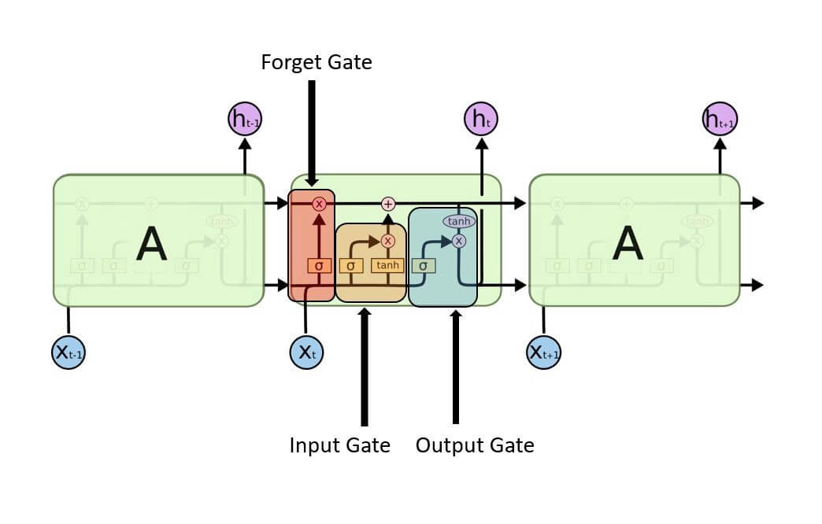
LSTM – LONG SHORT TERM MEMORY
LSTM (Long Short-Term Memory) is a recurrent neural network (RNN) architecture widely used in Deep Learning. It excels at capturing long-term dependencies, making it ideal for sequence prediction tasks.
Unlike traditional neural networks, LSTM incorporates feed-back connections, allowing it to process entire sequences of data, not just individual data points. This makes it highly effective in understanding and predicting patterns in sequential data like time series, text, and speech.

Slide 8



The cells store information, whereas the gates manipulate memory. There are three entrances:
Input Gate: It determines which of the input values should be used to change the memory. The sigmoid function determines whether to allow 0 or 1 values through. And the tanh function assigns weight to the data provided, determining their importance on a scale of -1 to 1.
Forgot Gate: It finds the details that should be removed from the block. It is decided by a sigmoid function. For each number in the cell state Ct-1, it looks at the preceding state (ht-1) and the content input (Xt) and produces a number between 0 (omit this) and 1 (keep this).
Output Gate: The block’s input and memory are used to determine the output. The sigmoid function determines whether to allow 0 or 1 values through. And the tanh function determines which values are allowed to pass through 0, 1. And the tanh function assigns weight to the values provided, determining their relevance on a scale of -1 to 1 and multiplying it with the sigmoid output.

Slide 9
ALGORITHM:
Feature Scaling (Preprocessing of Data):
Feature scaling involves bringing all feature values to a similar scale. In the context of LSTM models, this step is crucial to ensure that the input features are on a similar scale(scaling values to a range of 0 to 1).
Split the Dataset for Train and Test:
The dataset is typically split into two parts: a training set and a testing set. The training set is used to train the model, while the testing set is used to evaluate the model's performance on unseen data.
Converting Features into NumPy Array and Reshaping:
Each sample in the dataset may have multiple features. The data needs to be reshaped into a 3D array (samples, time steps, features) suitable for LSTM
Build the Architecture for the LSTM Network:
This involves deciding the number of LSTM layers, the number of neurons in each layer, activation functions, dropout layers for regularization, and defining input and output layers.
Compile and Fit the Model (Training):
Compile the LSTM model by defining the loss function, optimization algorithm, and metrics to be used to evaluate the model.
Evaluate the Performance of the Model (Test):
Finally, the trained model is tested on the unseen test dataset. Metrics such as accuracy, mean squared error (MSE), or others relevant to the problem domain are calculated to assess how well the model performs on new, unseen data.

Slide 10
Flowchart
Start
HTML Page
Enters the Email inText Format
Data Processing
Yes
If Spam
End
Displays It’s a Spam mail
No
Displays It’s not a Spam mail

Slide 11
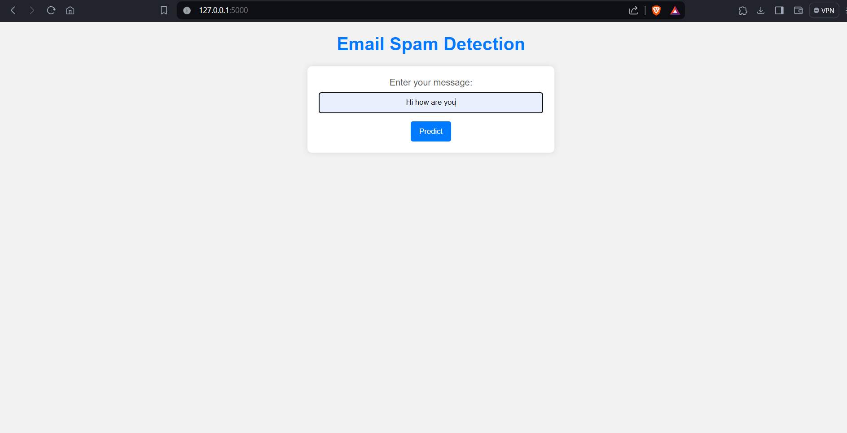
INPUT

Slide 12
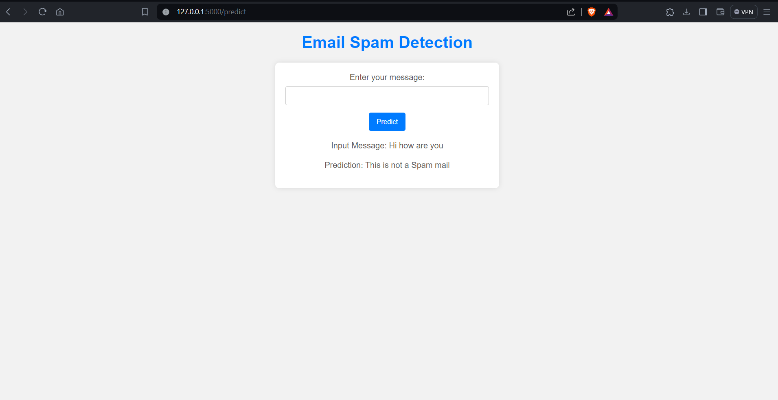
OUTPUT

Slide 13

Conclusion
Email spam detection will continue to evolve as spammers find new ways to bypass filters. It's important for individuals and organizations to stay vigilant and adopt the latest countermeasures to protect against spam.

